Slide 1
Chapter 9
Policy Preview

Slide 2
Introduction
Examine how the central bank sets interest rates in order to control aggregate demand
Begin with a “media level” description of the operation of central bank policy (who, what, why, when, and how)
Fundamentally, the central bank moves interest rates in response to deviations of output and inflation from desired levels → a notion that is summarized by the Taylor rule

Slide 3
The Who of Policy
Although both fiscal and monetary policy can be used to fine tune the economy, as a practical matter, most short-run fine tuning is done with monetary policy
The “who” of stabilization policy = central bank
In the U.S., the central bank is the Federal Reserve Bank
Formally, U.S. monetary policy is established by vote of the Fed’s Open Market Committee (FOMC)
The chairman can typically swing that vote
In some other countries, the formal decision making authority is vested solely in the governor of the central bank

Slide 4
The What of Policy
What the Fed actually does is set a key interest rate in the economy → the federal funds rate
Raising interest rates tends to cool off the economy
Lowering interest rates tends to heat up the economy
Lower interest rates encourage greater investment spending and greater spending on some consumption goods, thus increasing AD
Monetary policy works through AD
Monetary policy has little influence on AS

Slide 5
The Why of Policy
Central banks choose short-run policy with two goals in mind:
Maintain high economic activity
Maintain low inflation rates
**An obvious conflict between these goals**
Additional conflict between central bank’s preferences and capabilities
Except at high inflation rates, boosting economic activity does much more to enhance economic welfare than does controlling inflation
Central banks focus on stabilizing economic activity around a sustainable goal (Y*) and have moved toward inflation targeting

Slide 6
“When” Policy Is Made
FOMC meets every six weeks and sets the federal funds rate
Fed tries not to “surprise” markets
Sends advance signals of the likely future path of interest rates
At each meeting appropriate language is chosen to describe the Fed’s thinking about the near future
Markets listen to these words closely and react to the signals that they send

Slide 7
“How” Policy Is Implemented
Fed “sets” the interest rate by buying or selling Treasury bills to lower or raise the interest rate
The Fed buys Treasury bills with money it prints (electronically)
Lowering interest rates means increasing the money supply
The increased money supply results, eventually, in increased prices

Slide 8
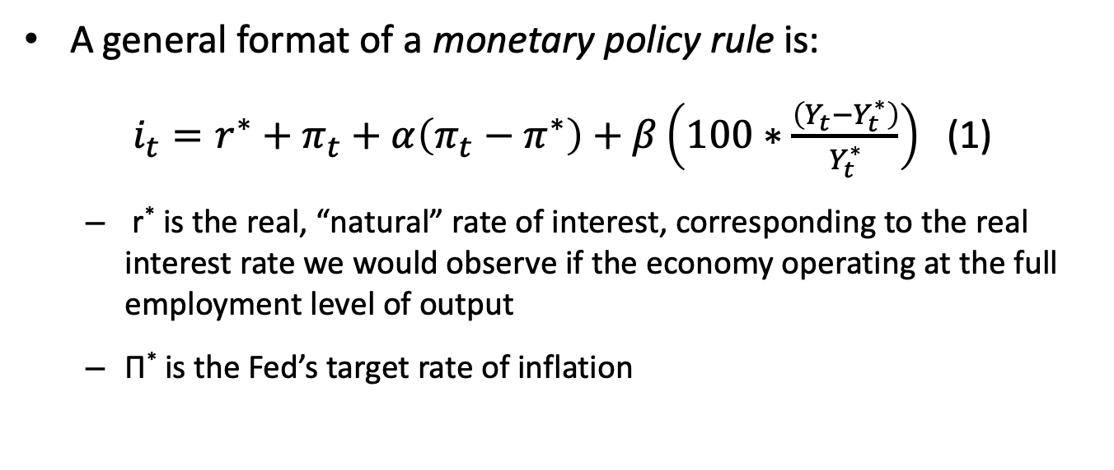
Policy as a Rule
When central bank sets the interest rate, makes a decision on the current economic situation
A general format of a monetary policy rule is:
$i_{t}=r^{∗}+π_{t}+α\left(π_{t}−π^{∗}\right)+β\left(100∗\frac{\left(Y_{t}−Y_{t}^{∗}\right)}{Y_{t}^{∗}}\right)$ (1)
r* is the real, “natural” rate of interest, corresponding to the real interest rate we would observe if the economy operating at the full employment level of output
Π* is the Fed’s target rate of inflation

Slide 9

Policy as a Rule
$$i_{t}=r^{∗}+π_{t}+α\left(π_{t}−π^{∗}\right)+β\left(100∗\frac{\left(Y_{t}−Y_{t}^{∗}\right)}{Y_{t}^{∗}}\right)$$
If α and β are large, then the monetary rule dictates aggressive responses to excess inflation and to economic booms
If α is large relative to β, then the monetary authority will respond much more aggressively to inflation than it will to the level of economic activity
The case of β=0 corresponds to pure inflation targeting

Slide 10

The Original Taylor Rule
$$i_{t}=2+π_{t}+0.5\left(π_{t}−π^{∗}\right)+0.5\left(100∗\frac{\left(Y_{t}−Y_{t}^{∗}\right)}{Y_{t}^{∗}}\right)$$

Slide 11
Example of Taylor Rule
$$i_{t}=2+π_{t}+0.5\left(π_{t}−π^{∗}\right)+0.5\left(100∗\frac{\left(Y_{t}−Y_{t}^{∗}\right)}{Y_{t}^{∗}}\right)$$
If inflation is running at 1 percent with a 2 percent target while GDP is 1 percent above potential, what is the federal funds rate?
What is the nominal interest rate to hit a 3 percent inflation target at full employment?

Slide 12
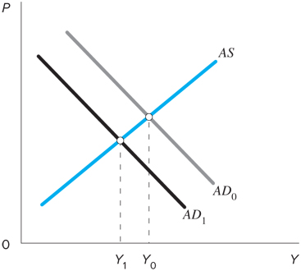
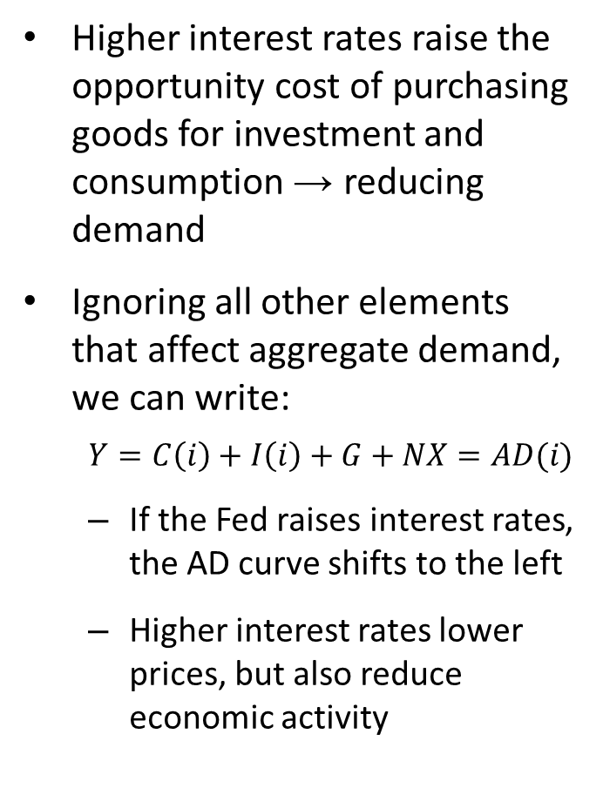
Calculating How to Hit the Target
Higher interest rates raise the opportunity cost of purchasing goods for investment and consumption → reducing demand
Ignoring all other elements that affect aggregate demand, we can write:
$$Y=C\left(i\right)+I\left(i\right)+G+NX=AD(i)$$
If the Fed raises interest rates, the AD curve shifts to the left
Higher interest rates lower prices, but also reduce economic activity

Slide 13
Calculating How to Hit the Target
Steps taken by a policy maker are:
Determining where output and the price level should be (or employment and inflation)
Determining how much they need to shift AD or AS to hit those targets
Determining how large a policy change is required to move the AD or AS the necessary distance

Slide 14
A Simplified Example
Assume unemployment rate is 6 percent.
Suppose you know that natural rate of unemployment is estimated to be 4.5 percent.
Suppose 1 percentage point cut in interest rates increases AD by 0.75 percentage points (assume Keynesian AS curve).
Change in unemployment rate?
Change in output or GDP?
Change in interest rate?

